Slide 1
Exception Handling & Utility Classes

Slide 2
Agenda
What is an exception error?
Why using exception handling?
Key words
Syntax
Common exceptions in C#
Example
User Defined Exception
Q&A

Slide 3
Agenda
What is an exception error?
Why using exception handling?
Key words
Syntax
Common exceptions in C#
Example
User Defined Exception
Q&A

Slide 4
What is an exception error?
An exception is a problem that arises during the execution of a program.
An exception is generally an error condition or other event that interrupts normal flow of execution in an application.

Slide 5
Agenda
What is an exception error?
Why using exception handling?
Key words
Syntax
Common exceptions in C#
Example
User Defined Exception
Q&A

Slide 6
Why using exception handling?
Exception include some information as stack trace, error code. It can support developer track root cause of an error.

Slide 7
Agenda
What is an exception error?
Why using exception handling?
Key words
Syntax
Common exceptions in C#
Example
User Defined Exception
Q&A

Slide 8
Key words
try: A try block identifies a block of code for which particular exceptions will be activated. It's followed by one or more catch blocks.
catch: A program catches an exception with an exception handler at the place in a program where you want to handle the problem. The catch keyword indicates the catching of an exception.

Slide 9
Key words
finally: The finally block is used to execute a given set of statements, whether an exception is thrown or not thrown.
  For example, if you open a file, it must be closed whether an exception is raised or not.
throw: A program throws an exception when a problem shows up. This is done using a throw keyword.

Slide 10
Agenda
What is an exception error?
Why using exception handling?
Key words
Syntax
Common exceptions in C#
Example
User Defined Exception
Q&A

Slide 11
Syntax
Exception are handled by a try statement. When an exception occurs, the system searches for the nearest catch clause than can handle the exception, as determined by the run-time type of the exception.
You can list down multiple catch statements to catch different type of exceptions in case your try block raises more than one exception in different situations.

Slide 12
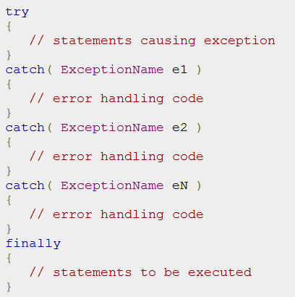

Syntax

Slide 13
Syntax
C# exceptions are represented by classes.
The exception classes in C# are mainly directly or indirectly derived from the System.Exception class.
Some of the exception classes derived from the System.
Exception class are the System.ApplicationException and System.SystemException classes.

Slide 14
Syntax
The System.ApplicationException class supports exceptions generated by application programs.
So the exceptions defined by the programmers should derive from this class.
The System.SystemException class is the base class for all predefined system exception

Slide 15
Agenda
What is an exception error?
Why using exception handling?
Key words
Syntax
Common exceptions in C#
Example
User Defined Exception
Q&A

Slide 16
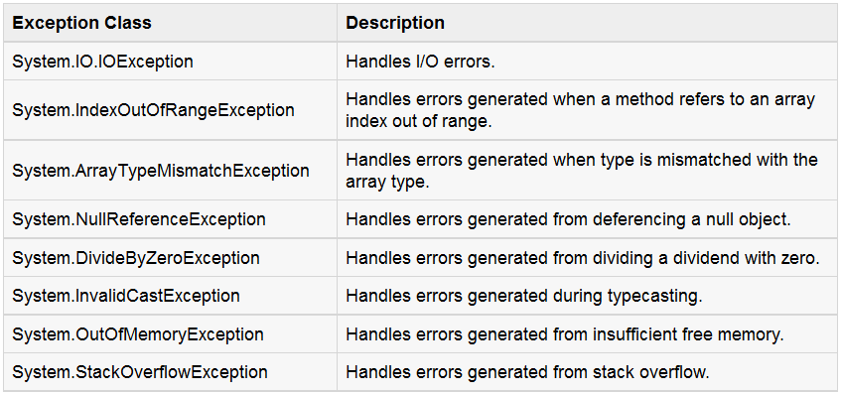
Common exceptions in C#
There are another Exception classes in C#, search about them !!

Slide 17
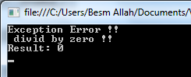
Example
class Program {
public static void division(int num1, int num2)
{
float result=0.0f;
try
{
result = num1 / num2;
}
catch (DivideByZeroException e)
{
Console.WriteLine("Exception Error !! \n divid by zero !!");
// Console.WriteLine("Exception caught: {0}", e);
}
finally
{
Console.WriteLine("Result: {0} ", result);
}
}
static void Main(string[] args)
{
division(10,0);
Console.ReadLine();
} }

Slide 18
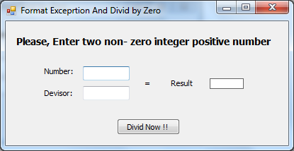
Example
catch (DivideByZeroException ex2)
{
// …..
}
catch (FormatException ex1)
{
//……
}
Try
ex1.Message
Try
Exception only
Instead of
DivideByZeroException
Or
FormatException

Slide 19
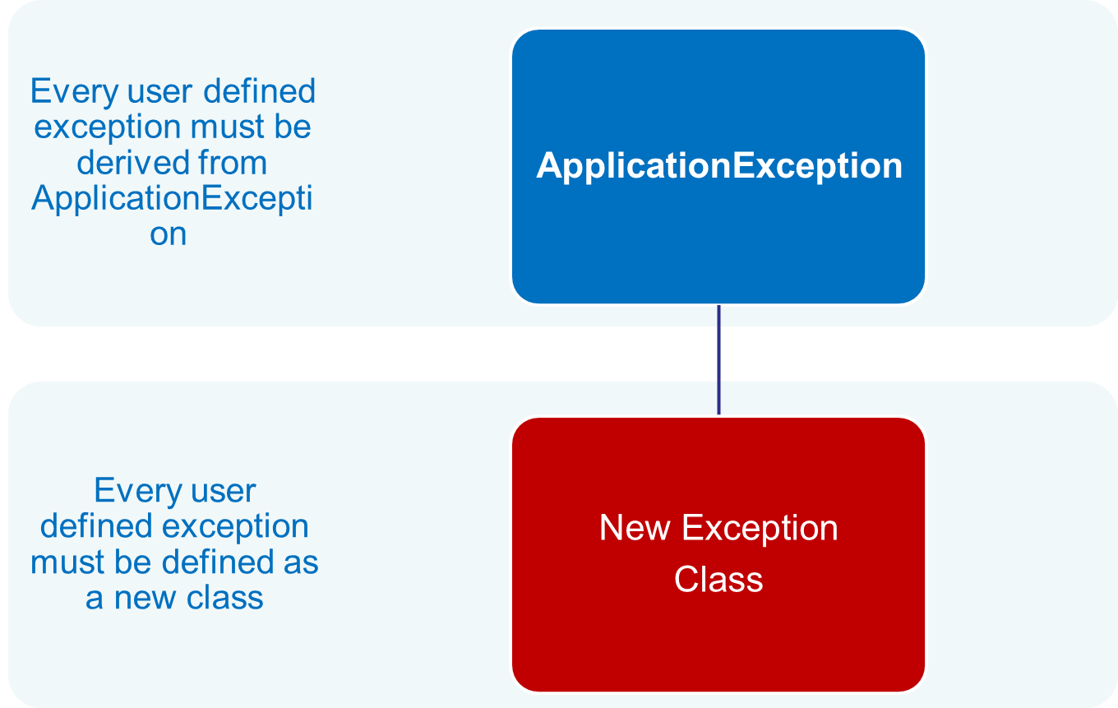
User Defined Exception

Slide 20
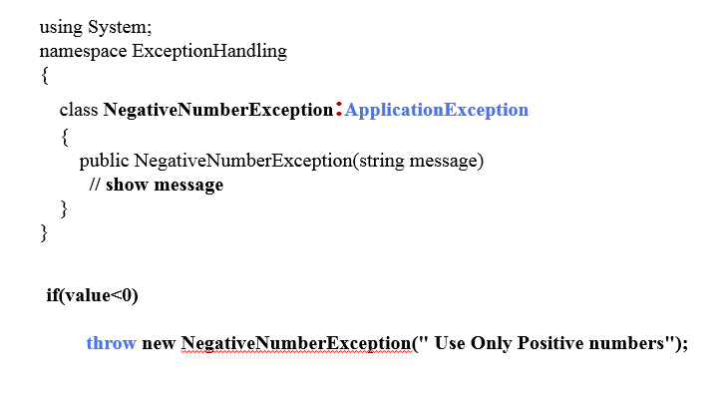
User Defined Exception

Slide 21
References
Exceptions and Exception Handling: http://msdn.microsoft.com/en-us/library/ms173160.aspx
Exception Handling Fundamentals: http://msdn.microsoft.com/en-us/library/2w8f0bss(v=vs.110).aspx
Notes:
Entity framework – framework ???

Slide 22
Question & Answer
Notes:
http://msdn.microsoft.com/en-us/data/dd363565.aspx

